Slide 1
IA Extra Project 2019 an example of a MLP classifier in Knime
Dott. Luca Cesarano
Fondamenti di Intelligenza Artificiale M
Prof. Paola Mello

Slide 2
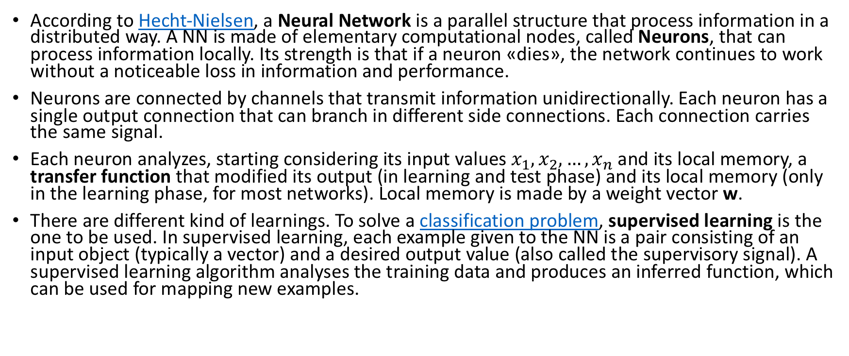
Neural Networks
According to Hecht-Nielsen, a Neural Network is a parallel structure that process information in a distributed way. A NN is made of elementary computational nodes, called Neurons, that can process information locally. Its strength is that if a neuron «dies», the network continues to work without a noticeable loss in information and performance.
Neurons are connected by channels that transmit information unidirectionally. Each neuron has a single output connection that can branch in different side connections. Each connection carries the same signal.
Each neuron analyzes, starting considering its input values $x_{1},x_{2},…,x_{n}$ and its local memory, a transfer function that modified its output (in learning and test phase) and its local memory (only in the learning phase, for most networks). Local memory is made by a weight vector w.
There are different kind of learnings. To solve a classification problem, supervised learning is the one to be used. In supervised learning, each example given to the NN is a pair consisting of an input object (typically a vector) and a desired output value (also called the supervisory signal). A supervised learning algorithm analyses the training data and produces an inferred function, which can be used for mapping new examples.

Slide 3
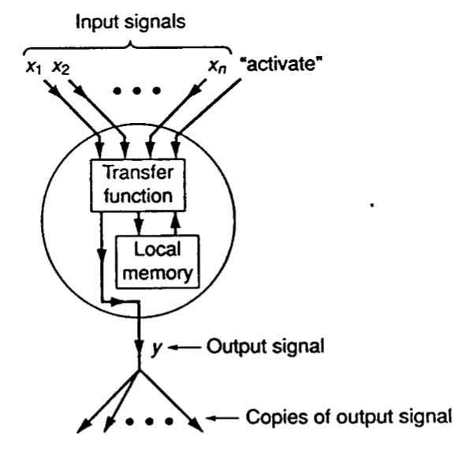
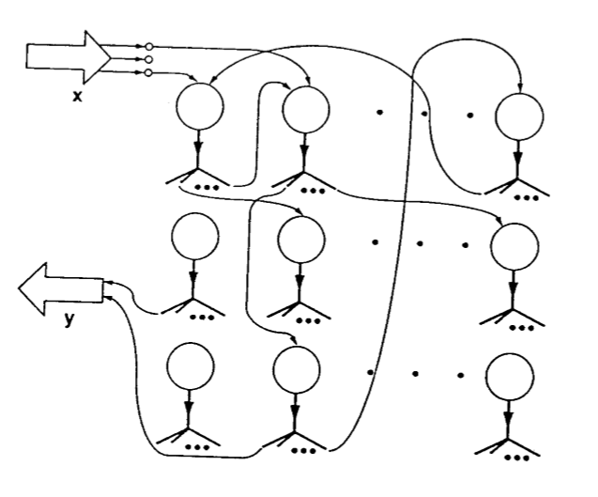
Neural Networks

Slide 4
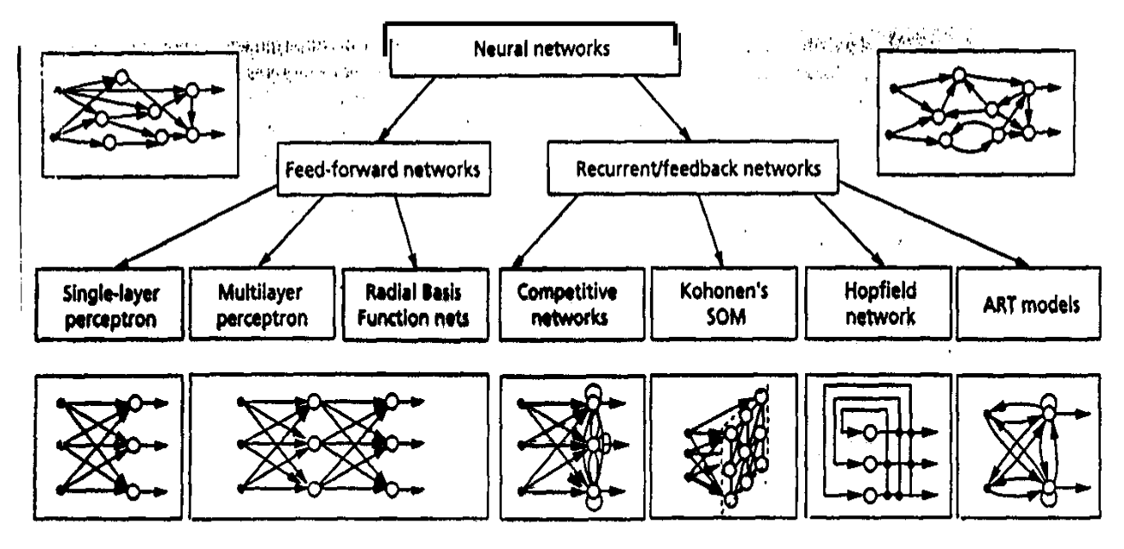
Neural Networks: Tassonomy

Slide 5
Multilayer Perceptron
A Multilayer perceptron (MLP) is a class of feed-forward artificial neural network. It consists of at least three layers of nodes: an input layer, a hidden layer and a output layer.
Learning algorithm: Performance Learning. Performance learning sets as goal the minimization (maximization) of a specific function, according to a specific performance index. Each neuron takes part in this phase.
Bias units are fictitious units whose purpose is to present each neuron with a fixed input of 1. MLP introduces non-linearities. This is the real advantage of the model because it allows to solve separable nonlinear problems (complex error surface). See also: XOR Problem.
Back propagation is a common method for training a (MLP) neural network.

Slide 6
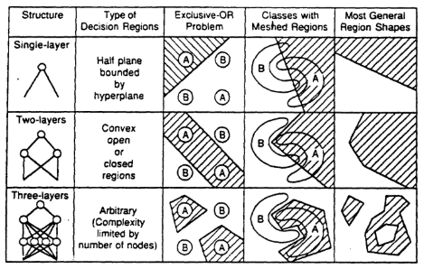
Multilayer Perceptron as a classifier
Output layer has the same number of neurons as the number of classes available.
Example: A,B,C as classes. Let us put an input s. Output: P(A|x) = 0.8; P(B|x) = 0.11; P(C|x) = 0.09.
Adopted strategy is of the kind “winner takes all”: “wins” the associated class to the neuron with the highest output. In this case, A wins.
Problems:
Presence of local minimums because of the complexity of the error surface. Can be solved modifying BP Algorithm.
Overtraining: NN too specialized, error increases proportionally with number of epochs.
Black-box system, it’s impossible to know the internal behaviour of neurons, but only their output.
Can’t work with small training sets; although works very well with large ones.

Slide 7
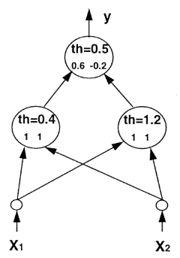
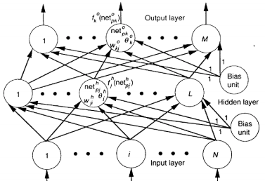
Multilayer Perceptron

Slide 8
Performance Evaluation
No free lunch theorem
There isn’t a classifier that always performs better than the others
It is then important to properly evaluate a classifier’s performance
Error estimation
if it is possible the dataset must be split into three sets:
• Training set (for training the classifier)
Validation set (for avoiding the overtraining)
Test set (for performance evaluation)

Slide 9
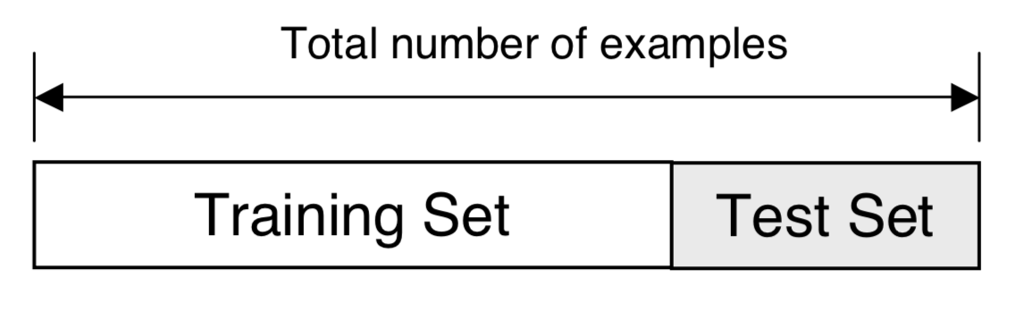
Hold-out
One of the methods to evaluate error estimation
Others (not discussed) are: K-fold cross validation & Bootstrap
Split dataset into two groups: 1. Training set: used to train the classifier 2. Test set: used to estimate the error rate of the trained classifier
Works well with large datasets

Slide 10
Classifier Complexity
There are several problems when the number d of the features to be used grows:
– computational complexity;
– Hughes phenomenon.
Computational complexity
– When the value of d grows, the computational complexity of the classifier increases. For some architectures such an increment is linear with d, for other architectures it is superlinear (e.g.: quadratic).
– The increase in complexity determines longer computational times and more significant memory requirements.

Slide 11
Hughes phenomenon (“curse of dimensionality”)
When d (the number of available features) grows, the amount of information for the classifier should grow, too. Therefore we might think that the accuracy should improve as well but...
On the contrary, fixing the number n of the training patterns, the probability of a correct decision of the classifier increases when 1 ≤ d ≤ d* and then decreases for d > d* (Hughes phenomenon).

Slide 12
Feature reduction
A possible solution is the reduction of the number d of the feature employed in the classification process (feature reduction).
Drawback: the reduction of the feature space implies a possible information loss.
There are two basic strategies for feature reduction:
– feature selection: the identification, within the set of the d available features, of a subset of m features. Such a subset is chosen so as to minimize the information loss, by using a predefined optimality criterion;
– feature extraction: a (often linear) transformation of the original (d- dimensional) feature space in another space having a dimension m<d, defined so as to minimize the information loss.

Slide 13
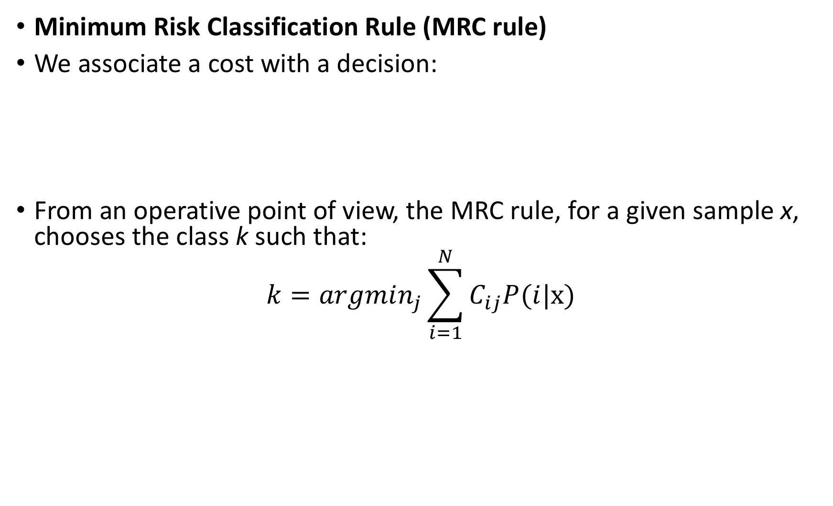
Reject Option
Minimum Risk Classification Rule (MRC rule)
We associate a cost with a decision:
From an operative point of view, the MRC rule, for a given sample x, chooses the class k such that:
$$k=argmin_{j}\sum_{i=1}^{N}{C_{ij}P(i|x)}$$
true/predicted classes | disease | normal | rejected
disease | 0 | 1000 | 1
normal | 10 | 0 | 1

Slide 14
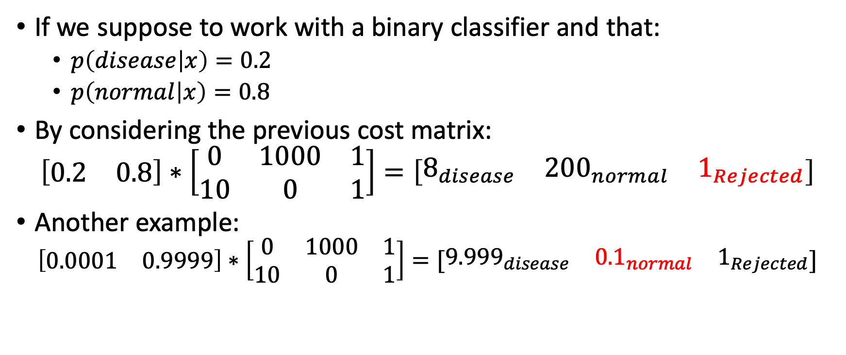
A numeric example
If we suppose to work with a binary classifier and that:
$p\left(disease | x\right)=0.2$
$p\left(normal | x\right)=0.8$
By considering the previous cost matrix:
$$\left[\begin{matrix}0.2 & 0.8\end{matrix}\right]∗\left[\begin{matrix}0 & 1000 & 1 \\ 10 & 0 & 1\end{matrix}\right]=\left[\begin{matrix}8_{disease} & {200}_{normal} & 1_{Rejected}\end{matrix}\right]$$
Another example:
$$\left[\begin{matrix}0.0001 & 0.9999\end{matrix}\right]∗\left[\begin{matrix}0 & 1000 & 1 \\ 10 & 0 & 1\end{matrix}\right]=[\begin{matrix}{9.999}_{disease} & {0.1}_{normal} & 1_{Rejected}\end{matrix}]$$

Slide 15
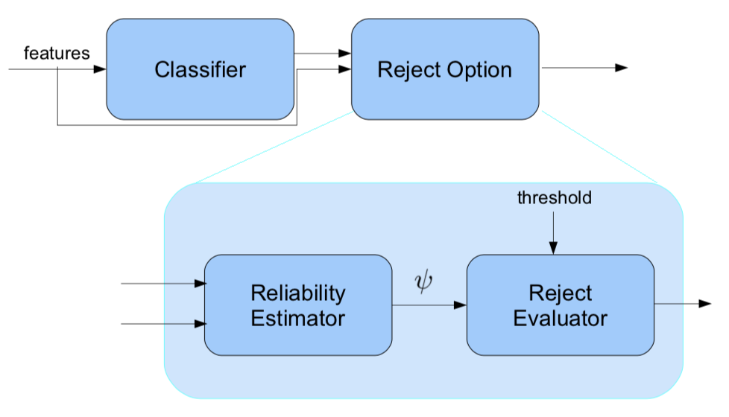
A possible Reject Architecture

Slide 16


Slide 17
What is Knime?
KNIME stands for Konstanz Information Miner
It is an Open Source Data Analytics, Reporting and Integration platform
Use a GUI to assembly ‘nodes’ for data preprocessing (ETL), modelling and data analysis and visualization
Modules for:
Data Mining
Data Analysis
Data Manipulation
Extra modules and extensions can be added!
Written in Java and based on Eclipse

Slide 18
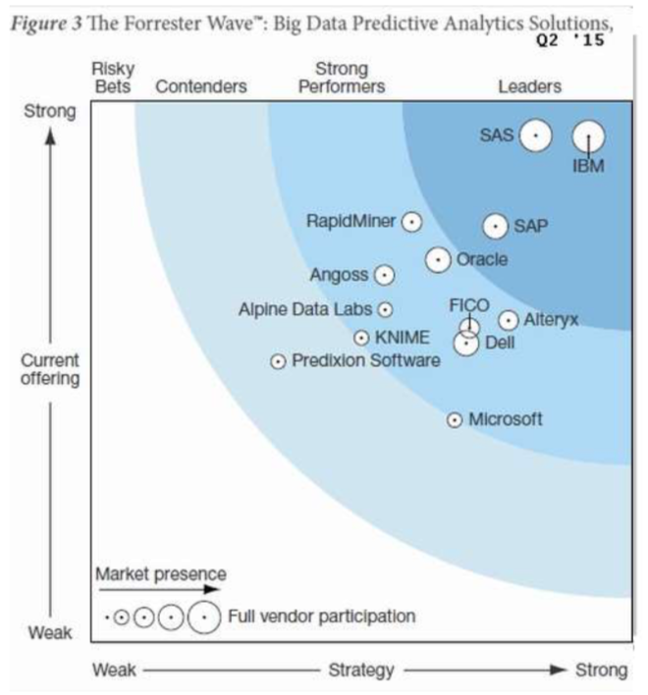
How does Knime compare with others?
Gartner’s Magic Quadrant for Advance Analytics Platforms.
Leaders quadrant in 2016 with SAS, IBM and Dell.
Strong Performer / Contender in Forrester’s Wave.

Slide 19
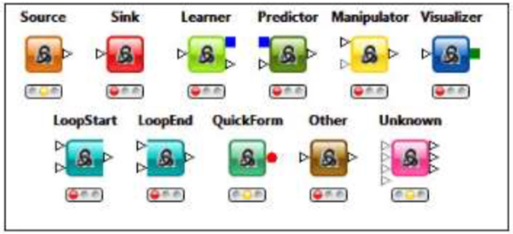
The Knime Way
Store your work in a workspace
Workspace can contain workflow groups built using the workflow editor
Workflows can contain nodes, meta nodes, connections, workflow variables, workflow credentials and annotations
Each node has a type, which identifies the algorithm associated with it
Nodes have parameters, inports and outports, and can have any of these states: • Misconfigured • Configured • Queued for Execution • Running • Executed

Slide 20
How to Build a Knime Workflow
Search in Node Repository
Dragging nodes into Workflow Editor
Connecting Nodes
Configuring Nodes
Executing (per node or one-shot)

Slide 21
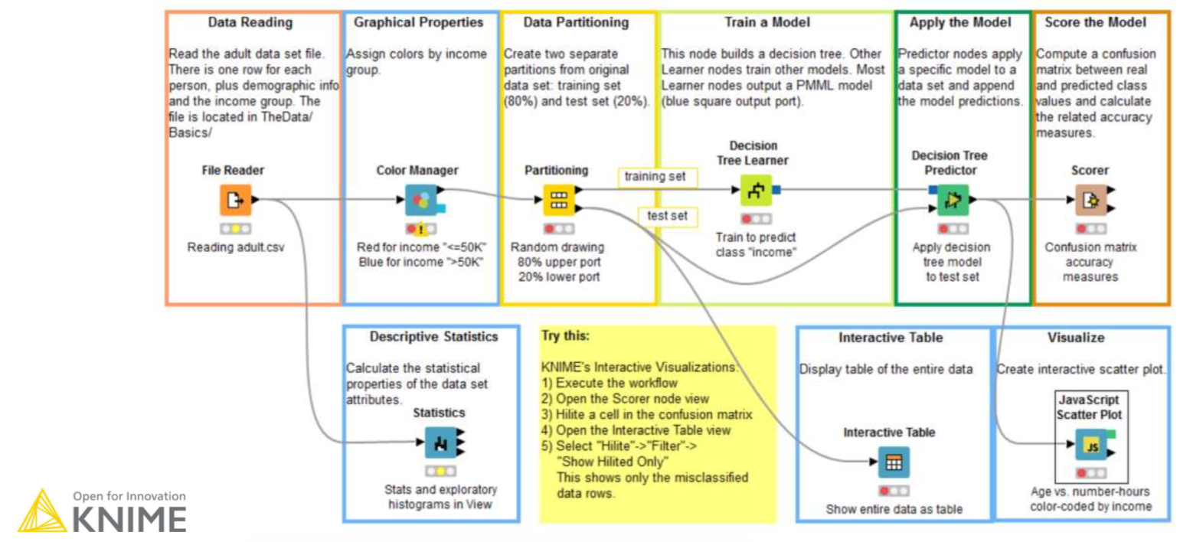
Simple Model Training for Classification

Slide 22
What is the goal of this project?
The goal is to classify whether there’s fog in the Paris’ airport with an anticipation of three hours.
Training data is in file TrainingSet.arff.
Test data to use after learning phase is named TestSet.arff
Cost Matrix is a txt file named costMatrix.txt
A pdf containing explanations on the metereological termininology is included.

Slide 23
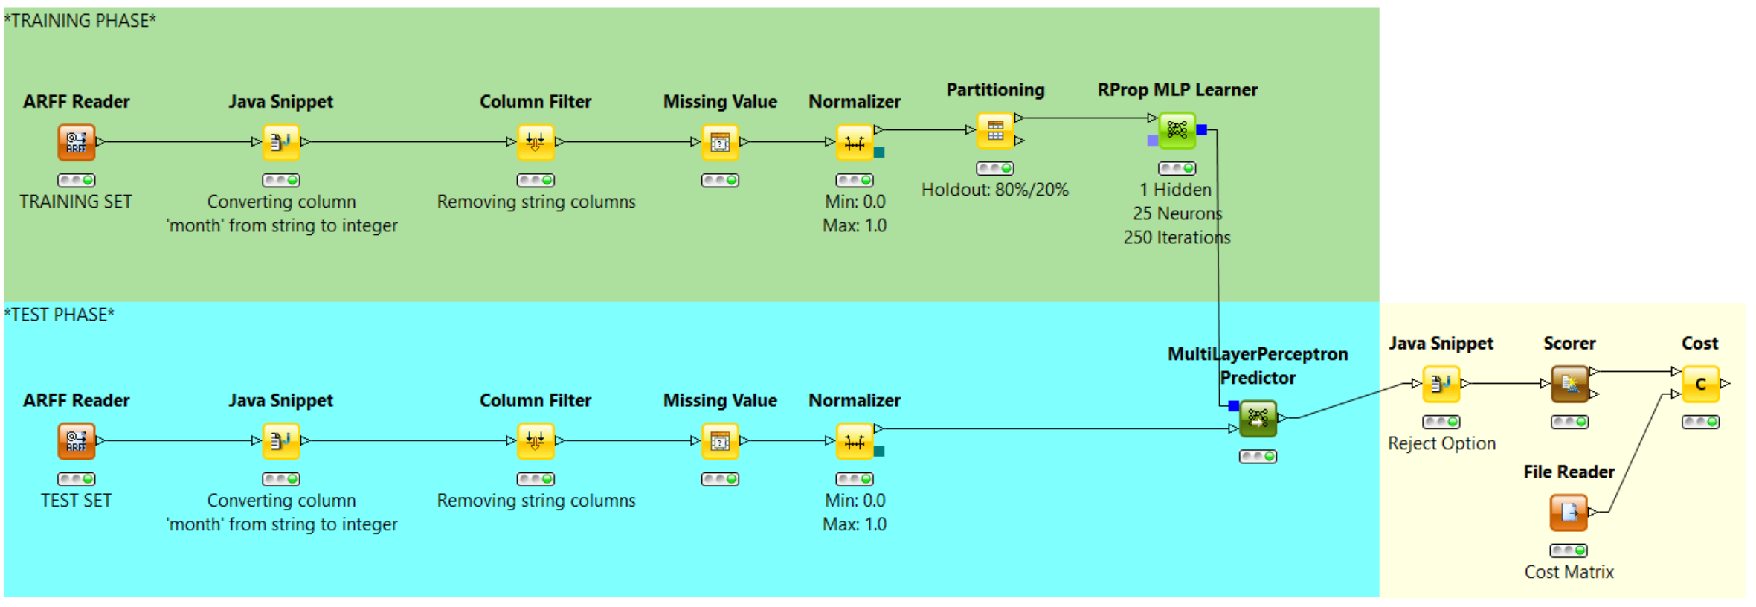
My MLP Classifier

Slide 24
Used nodes
Workflow is split in two parts: one for learning (above), one for testing (below).
ARFF Reader: This node reads in ARFF data from an URL. Insert training (above) and test (below) set to load here.
Column Filter: This node allows columns to be filtered from the input table while only the remaining columns are passed to the output table. In this project all string attributes are going to be excluded.
Missing Values: This node helps handle missing values found in cells of the input table. Integer values are replaced with a “most frequent” value; doubles with a “mean” value and strings with a “most frequent” value. Unknown values are removed.
Normalizer: This node normalizes the values of all (numeric) columns. In this project values normalized between 0.0 and 1.0.
Partitioning: The input table is split into two partitions (i.e. row-wise), train and test data. This is called Holdout method and it’s the simplest kind of cross-validation. Good for large data sets.

Slide 25
Used nodes
MLP Learner: Implementation of the RProp algorithm for multilayer feedforward networks. RPROP performs a local adaptation of the weight-updates according to the behavior of the error function. I used a three layers MLP (1 hidden layer) set with 250 iterations (epochs) and 25 neurons.
MLP Predictor: Based on a trained MultiLayerPerceptron-model given at the model inport of this node, the expected output values are computed. Missing values needs to be treated properly. Show as output test data to classify. Reject option is to be followed after this.
Reject Option: Given a specific cost matrix, we’re going to reject some classified data given from the MLP Predictor.
Scorer: After Reject Option with a given cost matrix, this module let us observe the data that got rejected for further inspections and the other data that are correctly classified.
Cost: outputs the classification cost. It is computed by multiplying each entry of the confusion matrix with the corresponding entry in the cost matrix and dividing the result by the total number of patterns. The node can also work with a classifier using a reject option.

Slide 26
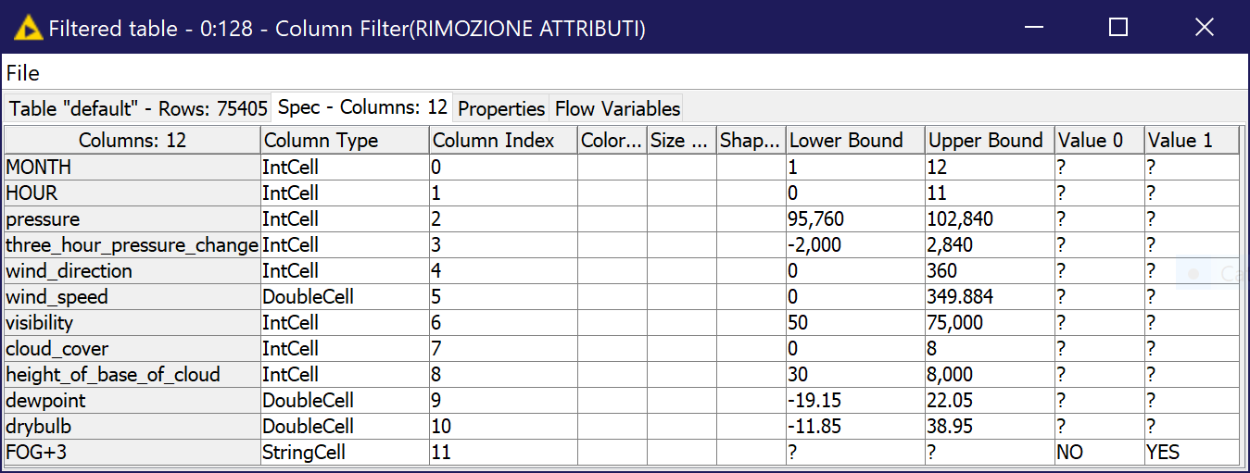
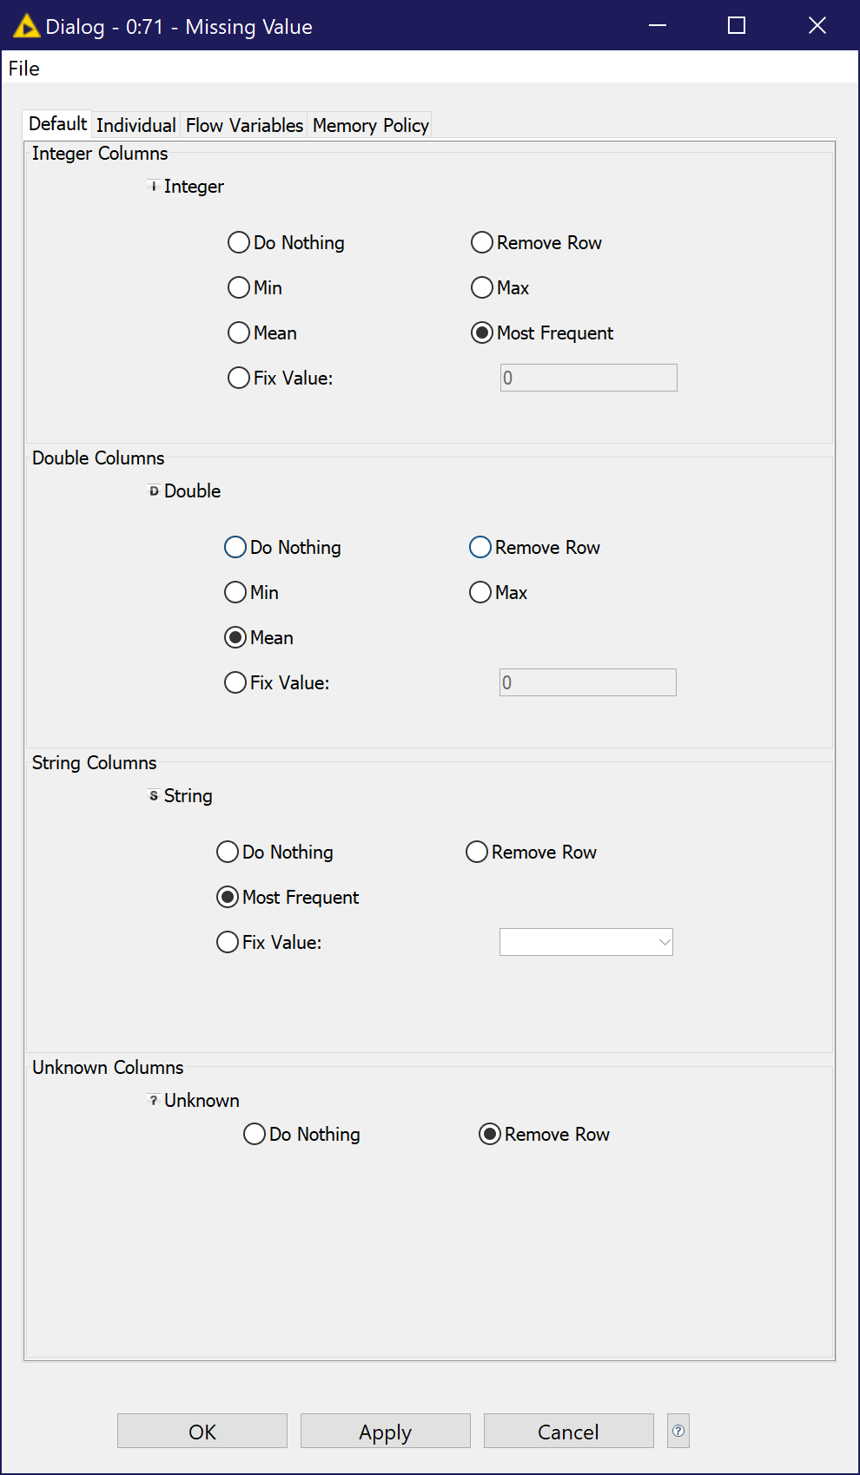
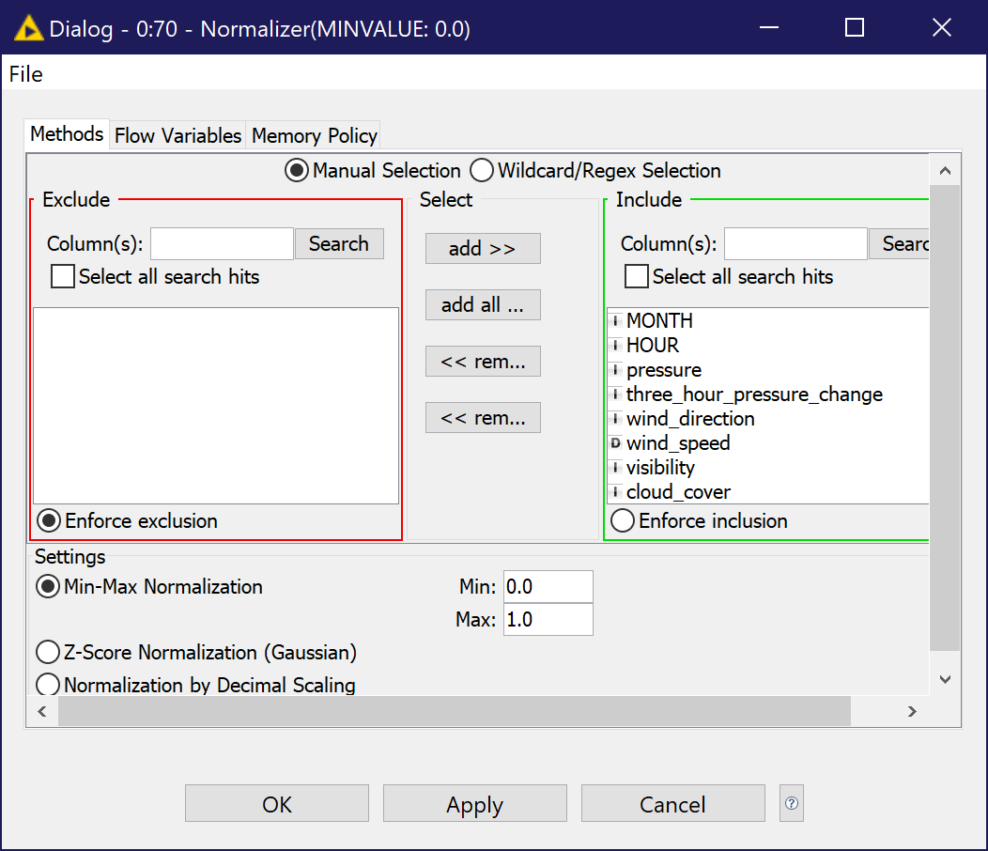
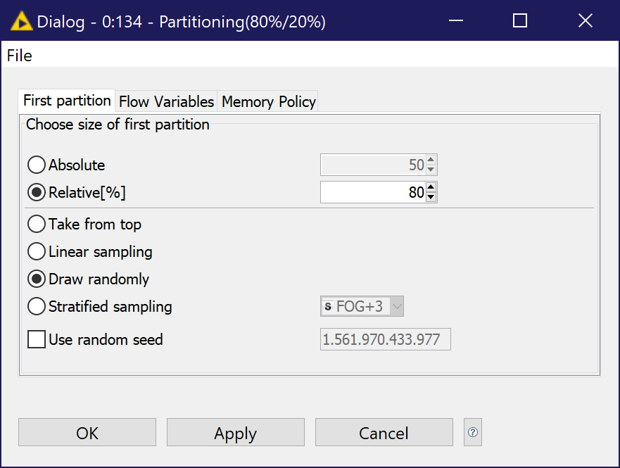

Slide 27
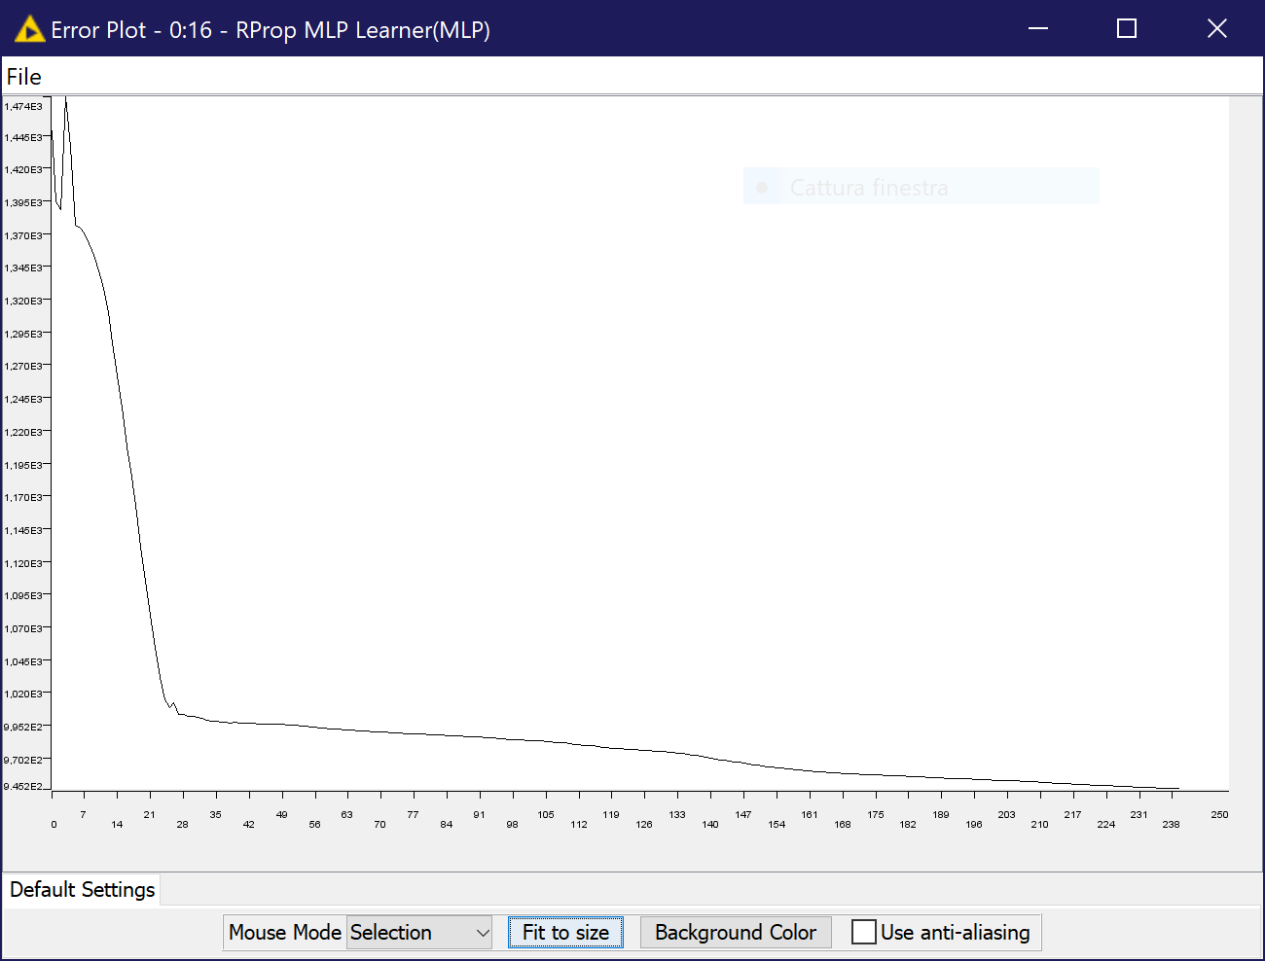
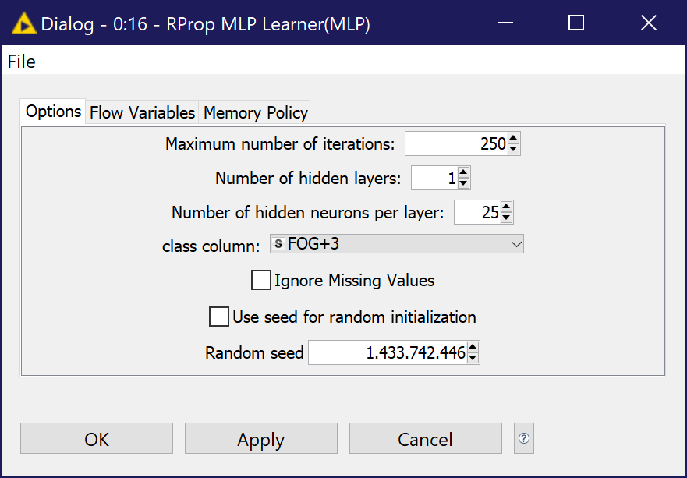
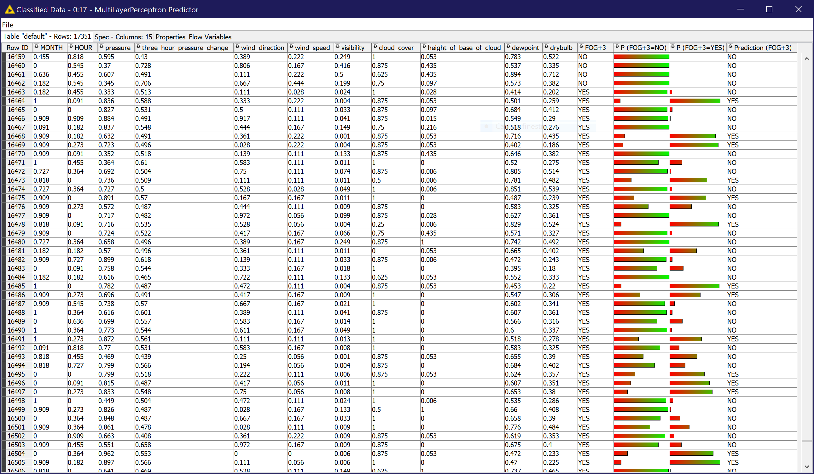
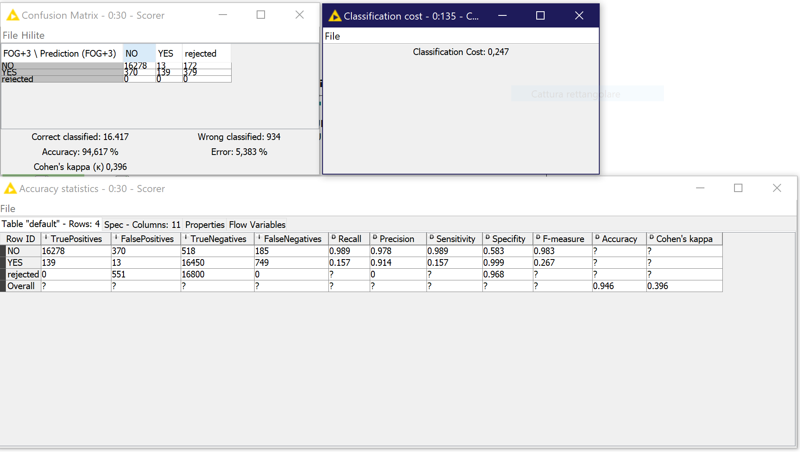

Slide 32
Information
KNIME: https://www.knime.com/
version used: 2.10.0 for Windows with all free extra addons
To obtain source code and extra modules, please contact me.
For extra information, please contact me.
If there’s any mistake, please contact me.
For anything else, please contact me. ☺
Reach me out @ luca.cesarano@studio.unibo.it

Slide 33
Thank you!

Slide 34
Appendix

Slide 35
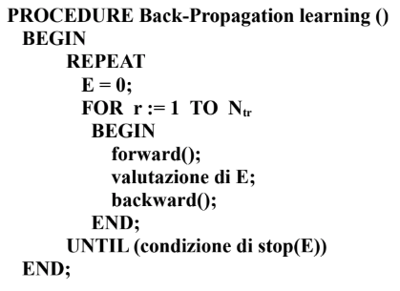
Back Propagation Algorithm
stop(E) condition: network sufficiently trained.
Training by pattern by default.
Training by epoch moving backward phase outside FOR Loop.
Real learning in internal loop:
forward: generic sample p goes as input in NN; each neuron computes; output layer shows f(p).
error evaluation: standard deviation of the error (possible because algorithm is supervised).
backward: according to this error, modify neurons’ weights with specific formulas. Modify also hidden layers’ neurons’ weights (using error gradient and derivative techniques).

